Slide 1
Export Cable Installation for the WindFloat Atlantic
Successes and Challenges of Connecting Floating Offshore Wind in the Atlantic
André dos Santos
5th November 2025
RPEI-PE
Aviso: | A reprodução ou comunicação, escrita ou verbal, ainda que parcial, deste documento, sem aprovação prévia da REN, SGPS é estritamente proibida e punida nos termos da lei. As informações contidas neste documento são propriedade da REN. Versões impressas deste documento podem não estar atualizadas e este documento assume o estado de “Cópia não controlada”.
Data: |  | Proprietário: | André dos Santos
Versão: | v1.0 | Aprovado por: | -
Classificação: | Publico | Lista de distribuição:

Slide 2
Project overview
Dynamic offshore cables
66 kV (40 MW) design
Point of common coupling at the edge of concession area (on seabed)
Drymate connector
Adapted from Windplus shared information

Slide 3
Licensing timeline
14 Nov 2015
[WFA] 1st Environmental Compliance Decision (Preliminary Engineering WFA+export cable)
4 Mar 2016
[REN] Permit for Exclusive Use of the National Maritime Space (TUPEM)
9 Dec 2016
[REN] The 81-A/2016 resolution of the Council of Ministers mandated REN to pursuit the engineering and environmental studies and construct the export subsea electric cable and provide a point of common coupling offshore Viana do Castelo for interconnection of the offshore Windfloat power plant. The infrastructure will was placed in operation in December 2019.
23 Jul 2018
[REN] Construction Permit
3 Out 2018
[REN] 2nd Environmental Compliance Decision (Front-End Engineering Design WFA+export cable)
17 Jan – 31 Dec 2019
[REN] Construction works

Slide 4
From the 1st Environmental Compliance Decision
For each side of the submarine cable installation corridor, a protection zone 250 meters wide will be established along its entire length.
The appropriate cable installation method will be chosen based on geological and metocean studies to be carried out prior to installation. To select the correct cable protection method, the existing risks associated with current fishing practices along its route and maritime traffic will be assessed.
Permit for Exclusive Use of the National Maritime Space (TUPEM)
16.554 km by 1 km maritime strip

Slide 5
Mitigation Measures
Environmental Compliance Decision (Front-End Engineering Design WFA+export cable)
Monitoring Programs
Archaeological Preservation
Monitor and preserve heritage sites using in-situ conservation whenever feasible.
Submarine Cable Burial
Bury submarine cable at maximum depth to minimize seabed disturbance and environmental impact.
Spill Prevention
Equip vessels with spill prevention protocols and containment measures.
Marine Habitat Conservation
Minimize sediment resuspension and disruption during installation activities.
Geological Substrate Surveys
Annual multibeam bathymetry surveys track changes in the seafloor geology and geological changes caused by project infrastructure..
Electromagnetic Field Modeling
Modeling evaluates potential effects on migratory fish, especially eels.
Marine Fauna Monitoring
Visual, acoustic, and radar surveys track cetaceans, birds, and bats in marine ecosystems.
Biodiversity Monitoring
Monitors colonization of structures, cetaceans, birds, bats, and fish interactions with cables.
Socioeconomic Engagement
Includes community complaint registry to ensure local concerns are addressed effectively.
Notes:
--- This slide references information from the following file: https://o365ren-my.sharepoint.com/personal/andre_santos_ren_pt/Documents/Ficheiros%20do%20Microsoft%20Copilot%20Chat/REC_1_2018_WF%20ATLT_DCAPE_.pdf To safeguard cultural and environmental assets, the project must implement a series of mitigation measures. These include archaeological monitoring and preservation of heritage sites, with in-situ conservation preferred whenever feasible. The submarine cable must be buried to the maximum viable depth to minimize seabed disturbance. Vessels involved in construction and maintenance must adopt spill prevention protocols and be equipped to contain accidental discharges. Additionally, installation activities must minimize sediment resuspension and disruption to marine habitats. These measures are designed to reduce the project's ecological footprint and protect sensitive areas throughout its lifecycle.

Slide 6
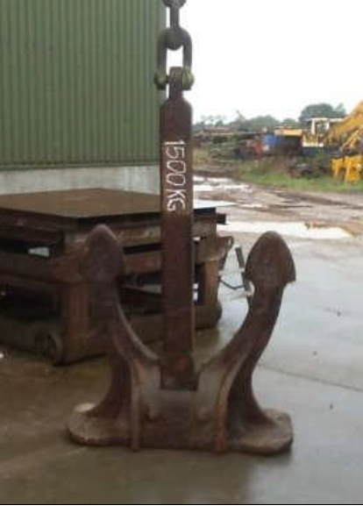
Cable Burial Risk Assessment (CBRA)
Seabed Condition Analysis
Analyze geological and geotechnical data to understand soil type and sediment stability.
Environmental Factor Assessment
Evaluate wave dynamics, currents, and seasonal changes impacting cable burial and stability.
External Risk Evaluation
Identify fishing, anchoring, and natural hazards that threaten cable integrity.
Burial Depth and Method Selection
Choose appropriate burial techniques like jetting and trenching to protect cables effectively.

Slide 7
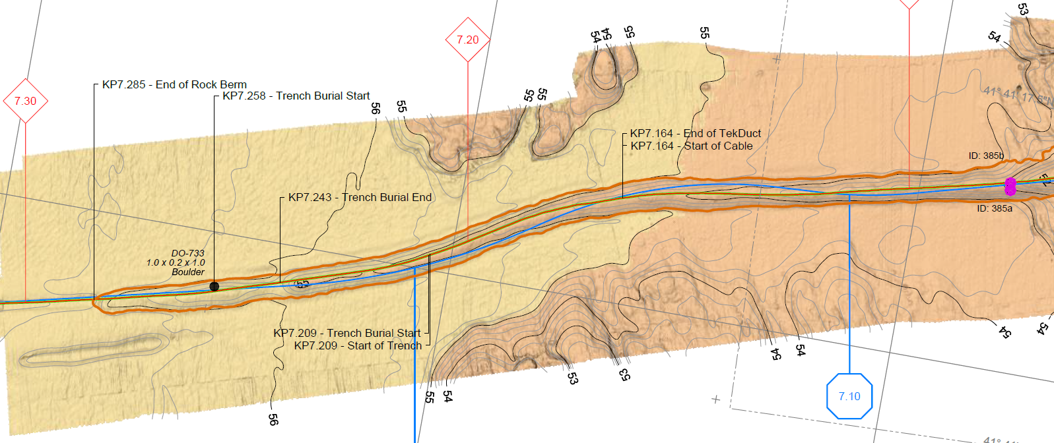
Cable micro-routing after geophysics surveys and CBRA
Trench burial PK 7 – 16,4 km
Rock berm PK 0 – 7 km

Slide 8
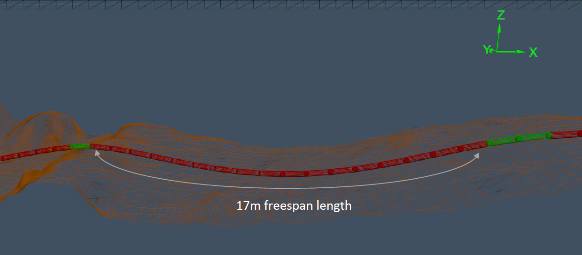
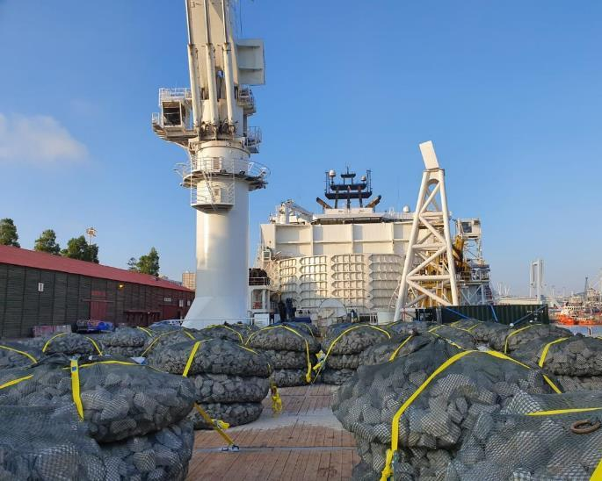
Rock Berm protection PK 0 – 7km
Touch surface preparation for cable lay
Cable points of contact may cause dangerous free spans
The free span length is reduced to acceptable sizes using rock bags placed at specific locations

Slide 9
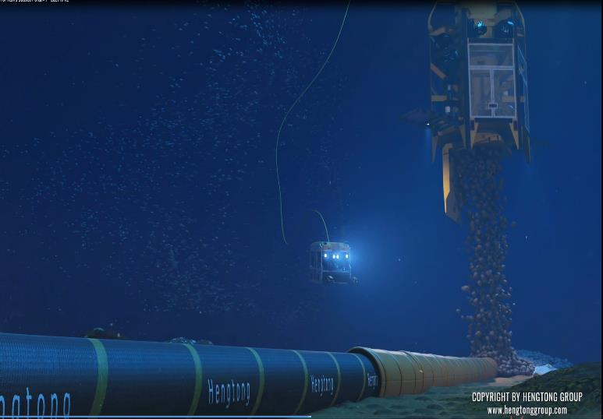
Rock Berm protection PK 0 – 7km
The CBRA⁽¹⁾ defined the design of rock berms according to the identified external threats:
Fishing gear
1.5t Anchor
131.000 tons of rock
1-8” grading was used as filter layer
LMA 5/40 was used as armor layer
⁽¹⁾Cable Burial Risk Assessment

Slide 10
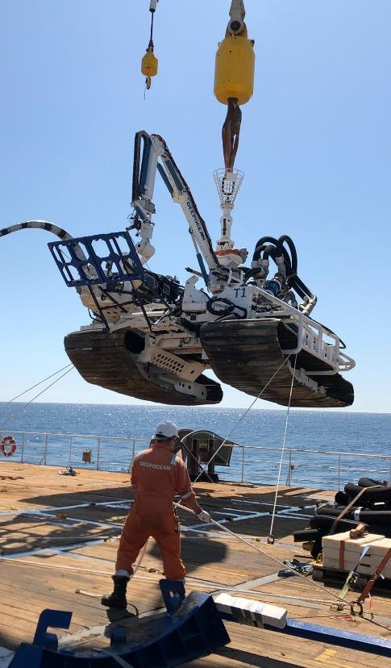
Trenching PK 7- 16,4 km
The CBRA defined:
Minimum Depth of Lowering
Trenching technique using jetting

Slide 11
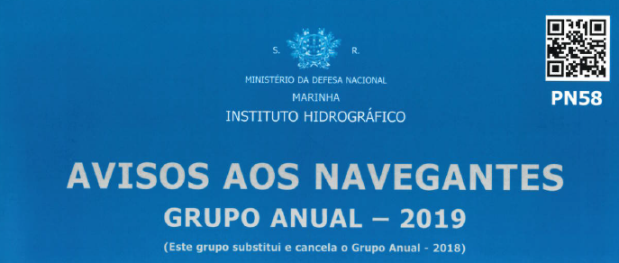
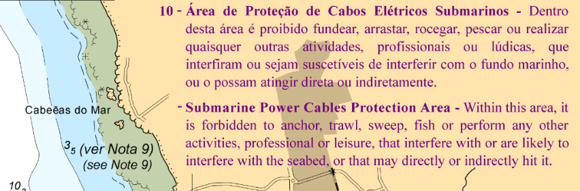
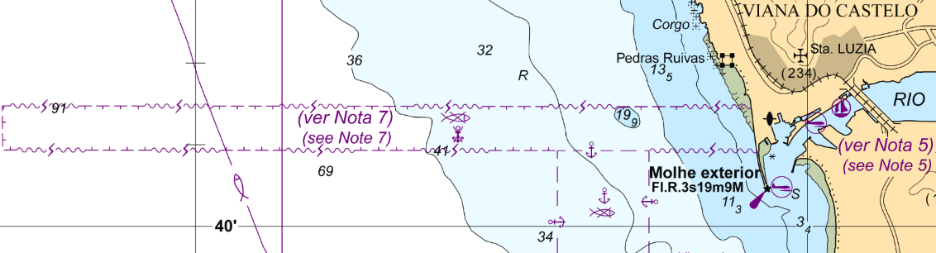
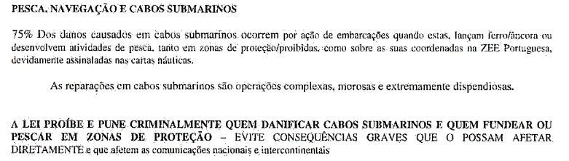
Fishing and other economic activities

Slide 12
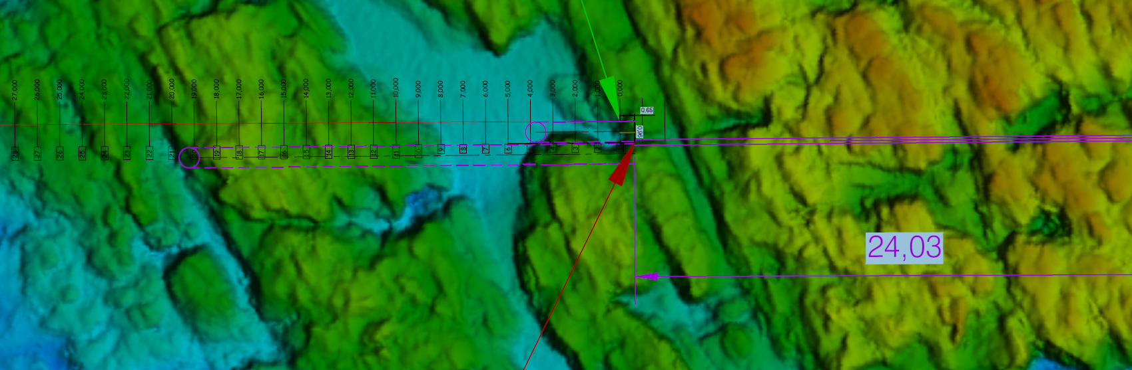
Cable Landfall - HDD
640 m length
Position of punching out

Slide 13


