Slide 1
Renewable Grid Initiative & OCEAN webinar: Lessons from the UK – Accelerating Offshore Wind & Nature Protection
Offshore Wind Consenting journey: An industry view
Version 1.0 12 November 2025

Slide 2
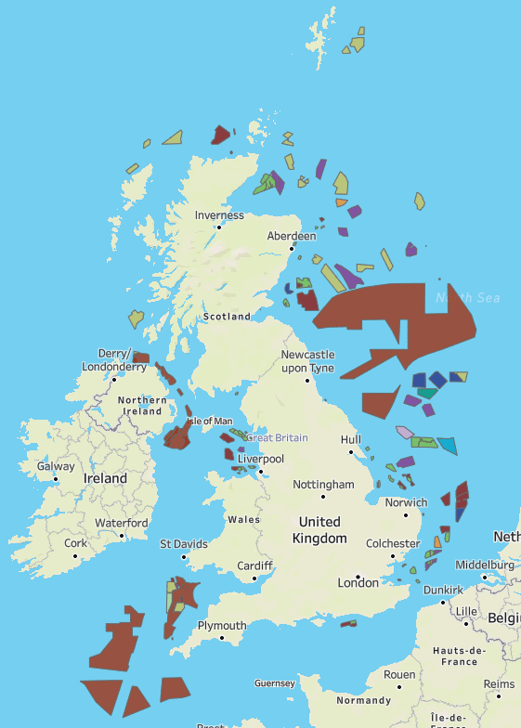
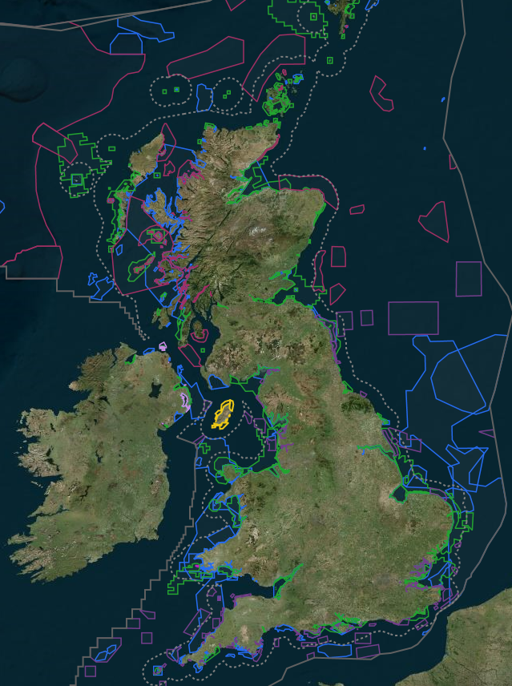
Offshore Wind & protected sites
RenewableUK EnergyPulse data – Nov 2025
UK National Sites Network (JNCC Marine Mapper) JNCC Web Mapper

Slide 3


Who we are
The UK’s leading not for profit renewable energy trade association.
RUK’s members are building the UK’s future energy system powered by clean electricity, with the aim of delivering that future faster, a future that is better for industry, billpayers, and the environment.
RUK supports over 400 member companies to ensure increasing amounts of renewable electricity are deployed across the UK and to access export markets all over the world.
RUK’s members are business leaders, technology innovators, and expert thinkers from across the industry
Offshore Wind Industry Council– senior level government and industry partnership
Actively drives progress towards offshore wind delivery, supported by an industry-funded work programme and dedicated team within RenewableUK
An ambitious, long-term strategy, in which offshore wind will become the backbone of the UK’s power system
Co-chaired by a Department for Energy Security and Net Zero minister and industry leader.
Consenting & Environment workstream
Notes:
We advocate passionately and successfully for the UK renewables industry, bringing our members together to amplify results and accelerate the journey to net zero.

Slide 4
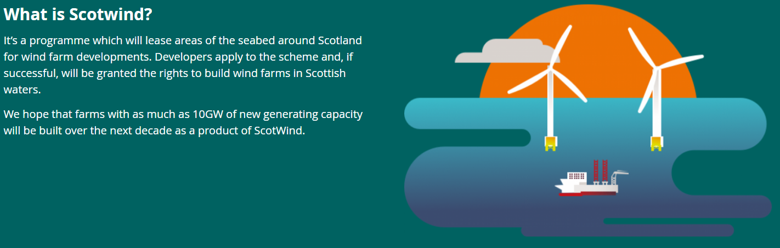
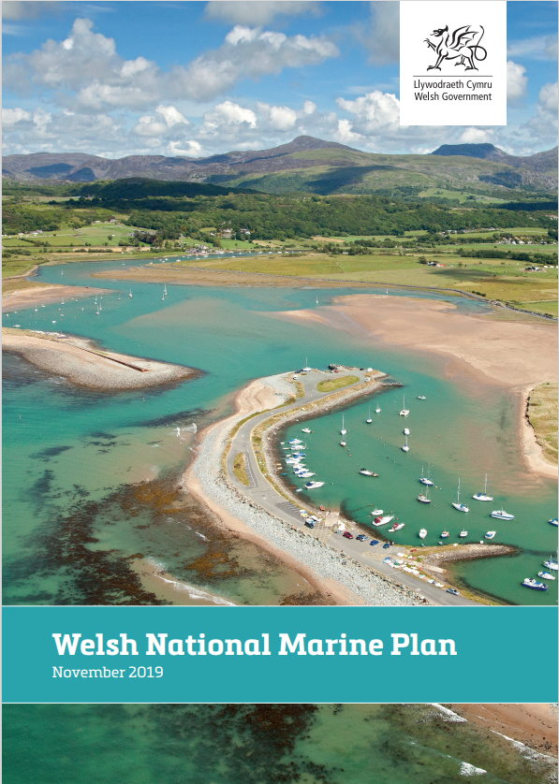
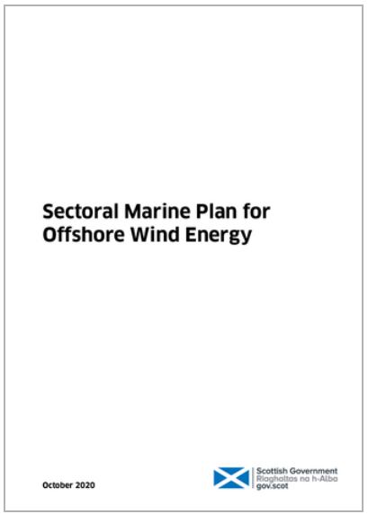
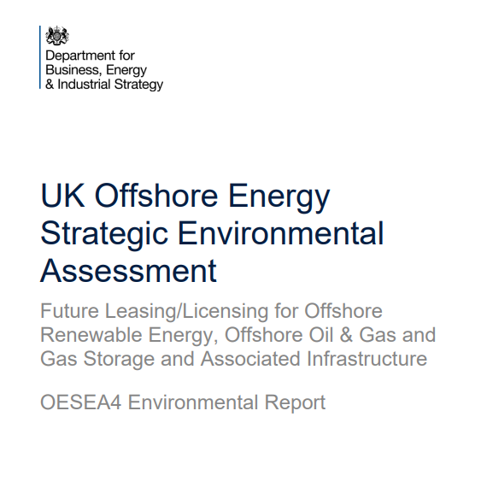
Offshore Wind Planning in the UK
Overarching
Offshore Energy Strategic Environmental Assessments (OESEA)
National & Regional Marine Plans
England: Regional Marine Plans
Wales: Welsh National Marine Plan
Scotland: National Marine Plan, with Sectoral Marine Plan for Offshore Wind
Seabed Lease
Granted by The Crown Estate and Crown Estate Scotland through a leasing round process, plan lead approach
Several rounds in UK from 2000
Project Level Consenting
Environmental assessments and project level consenting
Development Consent Orders, Marine Licences, Section 36 generating consents

Slide 5
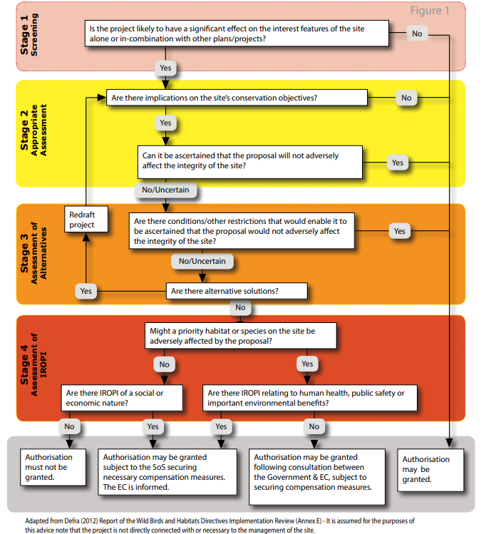
Consenting processes & Environmental Assessments
Consent applications
Development Consent Order under Planning Act 2008 process in England & Wales, Marine Licence & Section 36 consent in Scotland.
Environmental Impact Assessment (EIA)
Understand and consider the potential environmental impacts of a project in the decision-making process, including where mitigation and compensation may be needed,
Findings presented in an Environmental Statement (ES) and Non-Technical Summary (NTS) both submitted with consent applications
Habitats Regulations Assessment (HRA) & Marine Conservation Zone Assessment (MCZ)
Staged process for assessing potential impacts to UK national sites network
HRA Screening and Report to Inform Appropriate Assessment (RiAA) submitted with consent applications
Other assessments
Shipping & Navigational Risk Assessment
Water Framework Directives Assessment
Commercial fisheries & Marine archaeology

Slide 6
Consenting Offshore Wind Project - Timeline
Year 1 | Year 2 | Year 3 | Year 4 | Year 5 | Year 6 - 7 |  | Year 8 -10 | Year 8 -10 | Year 10 – 35 | Year 35 +
Award of seabed lease from TCE | Commence bird / marine mammal surveys | Complete environmental surveys | Complete environmental surveys | Consent Examination / Determination Phase | Consent Compliance |  | Construction | Construction | Operation | Decommissioning
 | EIA Scoping | Commence EIA surveys and studies | Complete EIA | Consent Awarded | Pre-Construction surveys and design |  | Environmental monitoring | Environmental monitoring | Environmental monitoring | Post Decommissioning Monitoring
 |  |  | Consent Applications Submission |  | Procurement
Stakeholder Consultation and Engagement
Pre - FEED |  |  |  |  | FEED

Slide 7
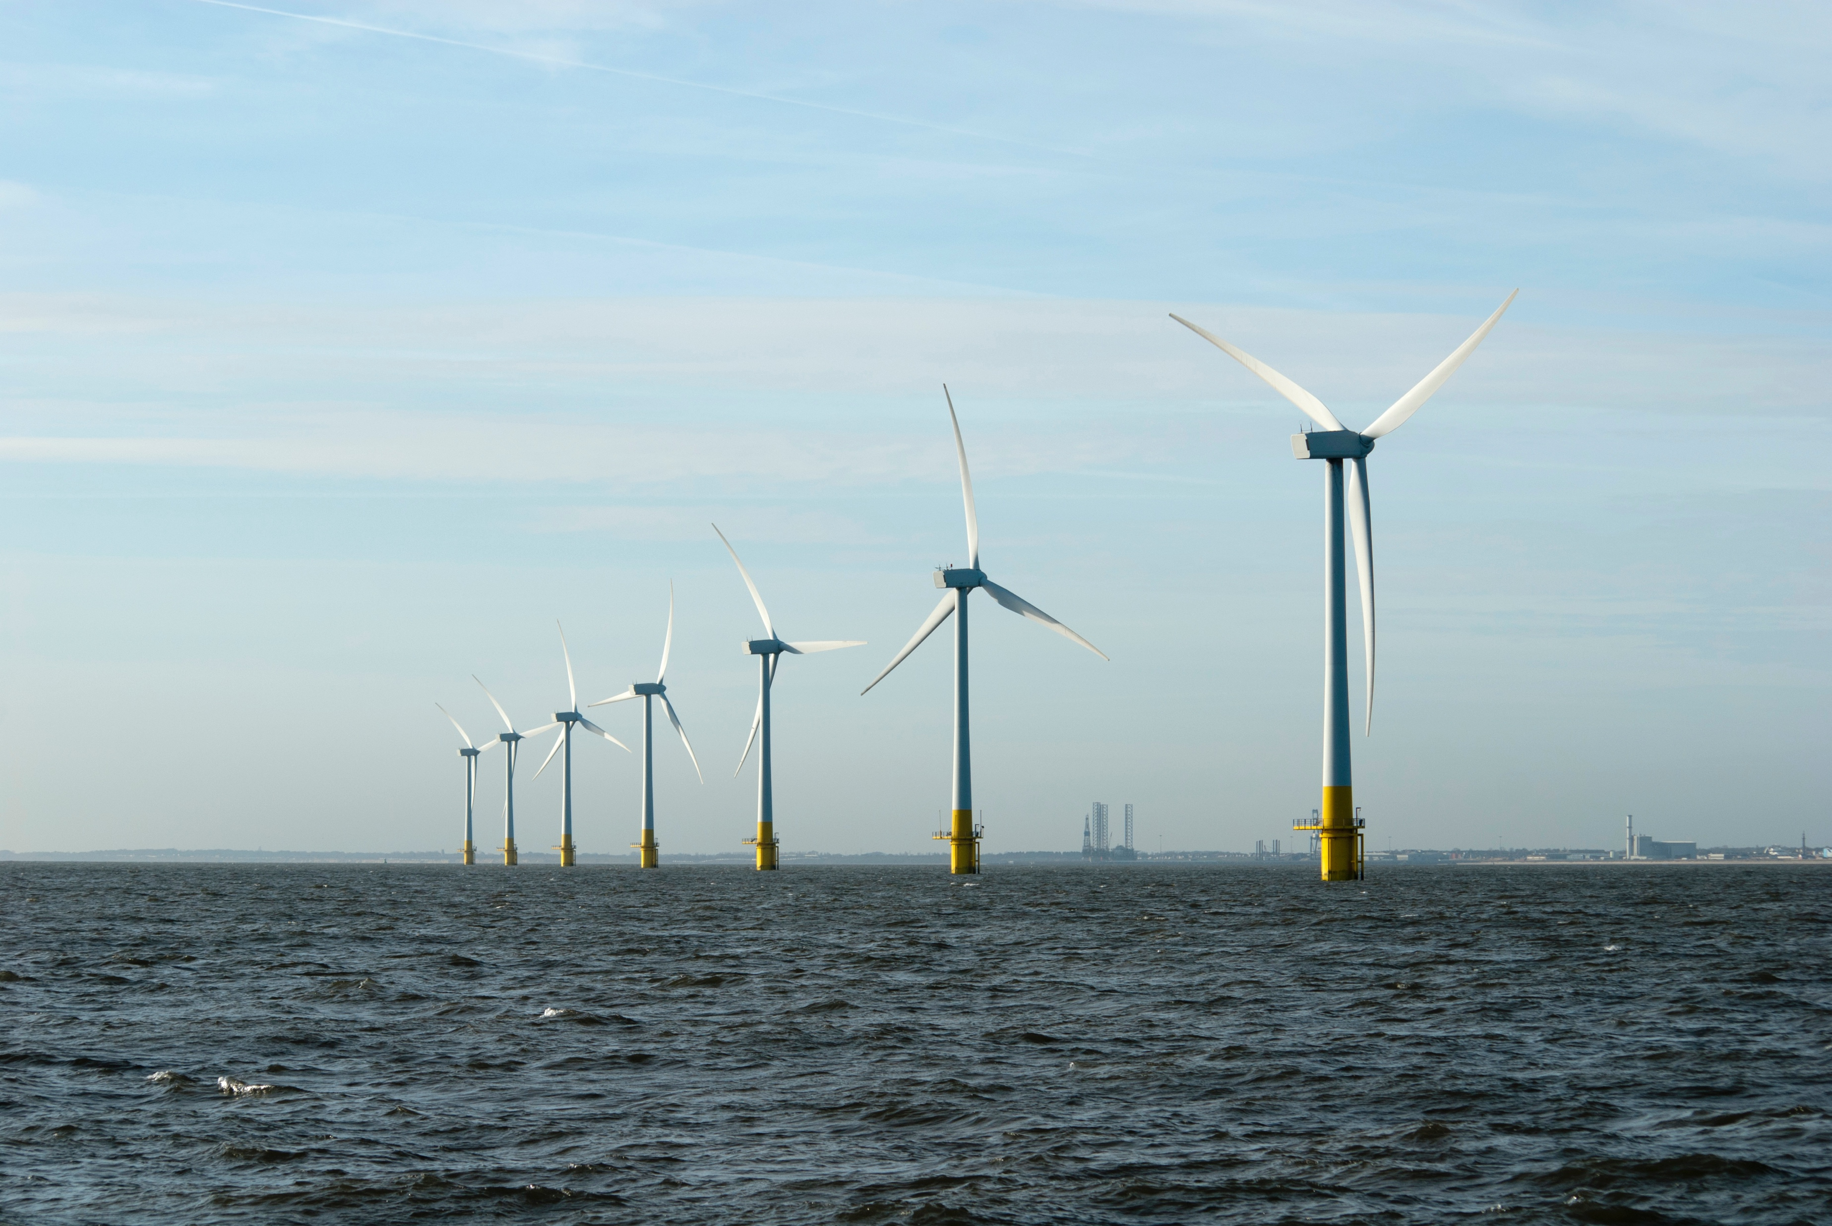
Key consenting challenges & how we are addressing them
OWIC Pathways to Growth Focus Areas
Strategic Compensation
- Marine Recovery Fund
- OWEC Strategic Compensation Studies
Strategic Planning
- Marine Delivery Routemap
- Marine Spatial Prioritisation
Adaptive Management
– better use of evidence & data
Underwater Noise
– Cross industry coordination
Cumulative Impact Assessments
– As-built register
Biodiversity Targets
Proportionate Assessments
Document title
Notes:
Uncertainty: costs & timelines
Consenting determination timelines being extended and increasing costs across all aspects, creating uncertainty
Strategic Compensation
Finding suitable compensatory measures for seabird and benthic features. Work underway with government to establish a Marine Recovery Fund

Slide 8



Thank you
Kat Route-Stephens – Head of Environment & Consents
Kat.route-stephens@renewableuk.com

