Slide 1
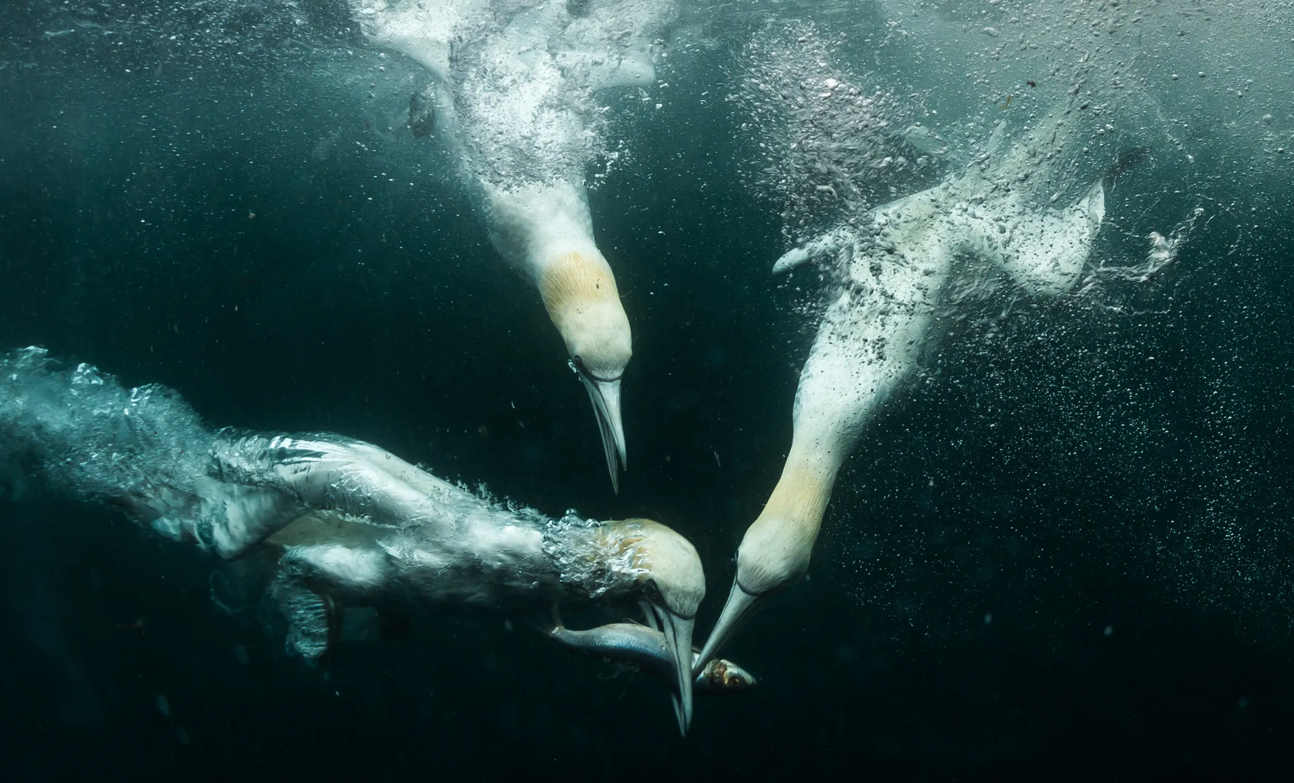
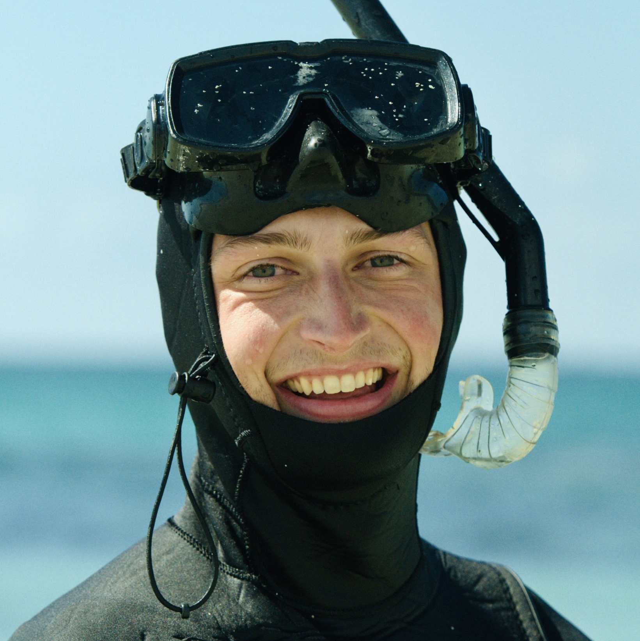
Lessons from the UK’s planning to consenting journey: Perspective from RSPB
Samuel Wrobel
Senior Marine Policy Officer

Slide 2
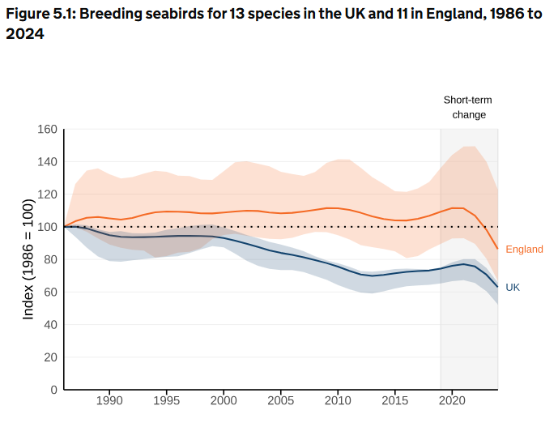
Status of UK seabirds
Failing to meet Good Environmental Status
62% decline across UK species
Suffered significant impacts from HPAI
5 new species added to the BoCC Red list
37% population decline in UK seabirds since 1986
Positive action to drive change through sandeel closure and development of four country seabird conservation strategies

Slide 3
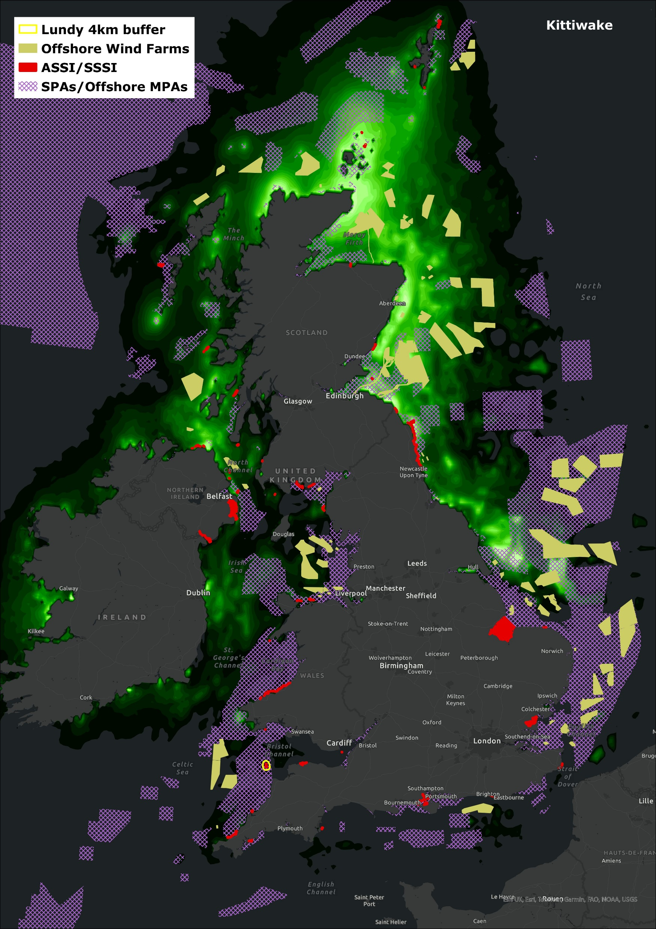
Spatial Planning
Protect Area network for seabirds (SPAs) doesn’t cover important areas at sea
Creates an ambiguous sea space picture
For complete sea user clarity = SPA sufficiency review is needed
Unlocking the future of offshore wind = capturing the needs of seabirds in future leasing
Natural England’s POSEIDON project will help finesse this

Slide 4
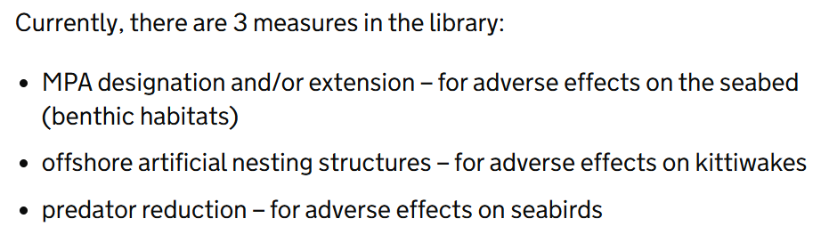

Strategic Compensation measures
Collaboration on Offshore Wind Strategic Compensation (COWSC) Library of measures
The challenge: How do we deliver effective measures for habitats and species, quickly, in line with demand for offshore wind deployment?
Combining developer ambition and innovation, alongside government
level intervention to drive seabird recovery. Status quo isn’t working.

Slide 5
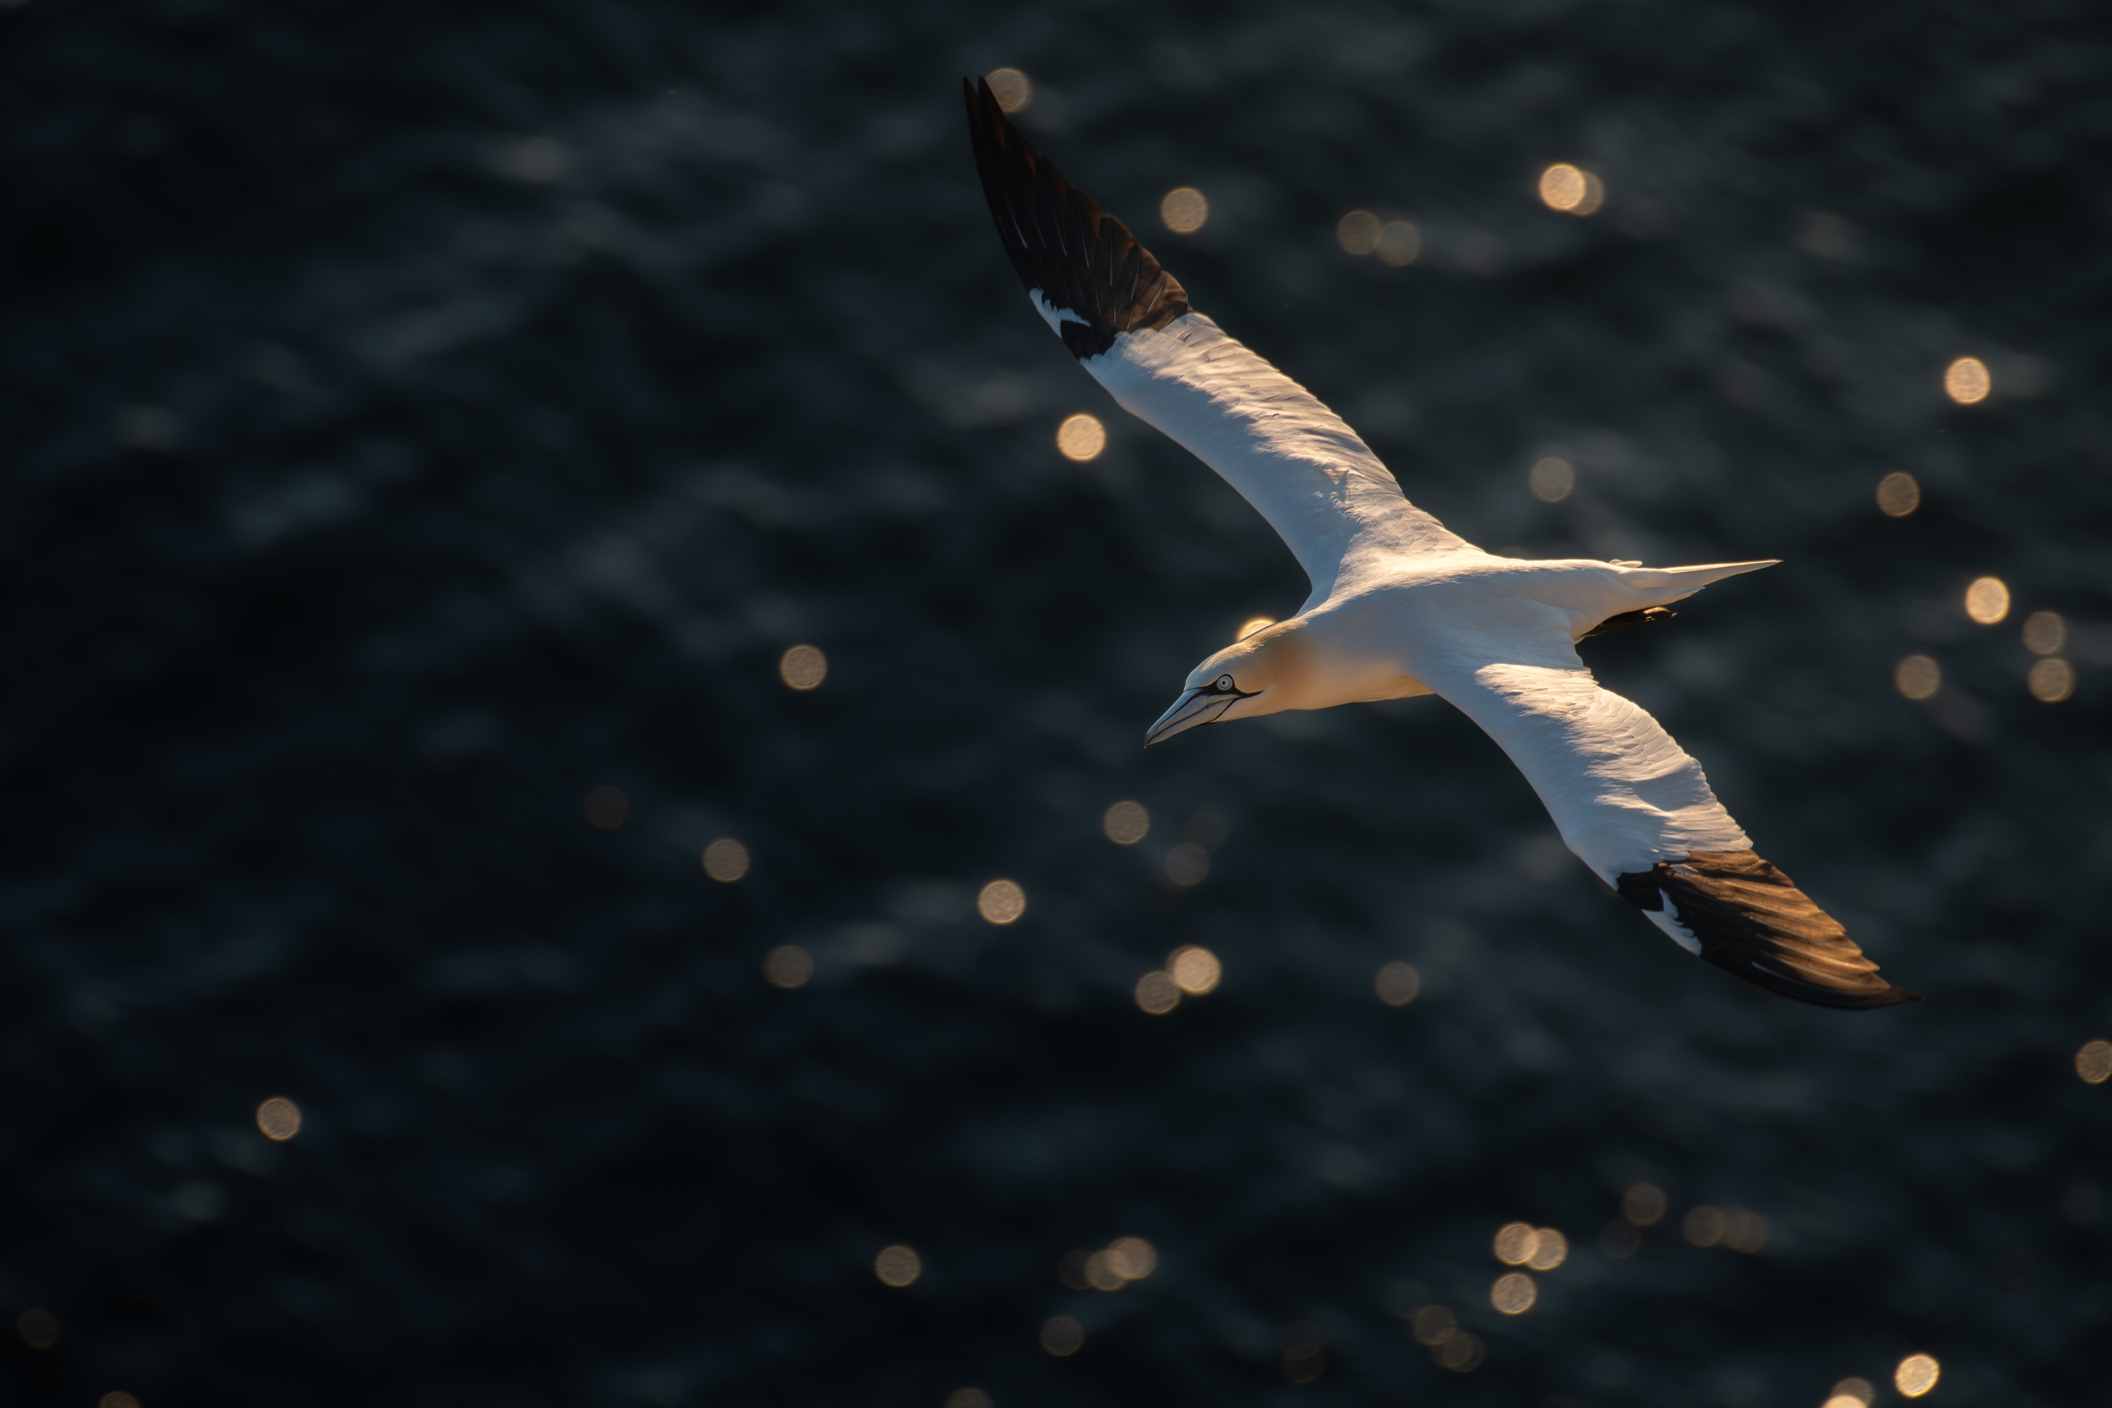

2030 and beyond
There are real challenges at play with the current pipeline that we need to unblock
Seabird packages to go beyond individual measures for better bang for our buck
  ESCaRP Breeding Colony Package
  Bycatch Mitigation Trials
  Isles of Scilly Predator Reduction pilot
Habitat Regulations Environmental Compensation reforms – opportunity and risk
Tim Slack

Slide 6
Thank you
Samuel Wrobel
Senior Marine Policy Officer
samuel.wrobel@rspb.org.uk

