Slide 1
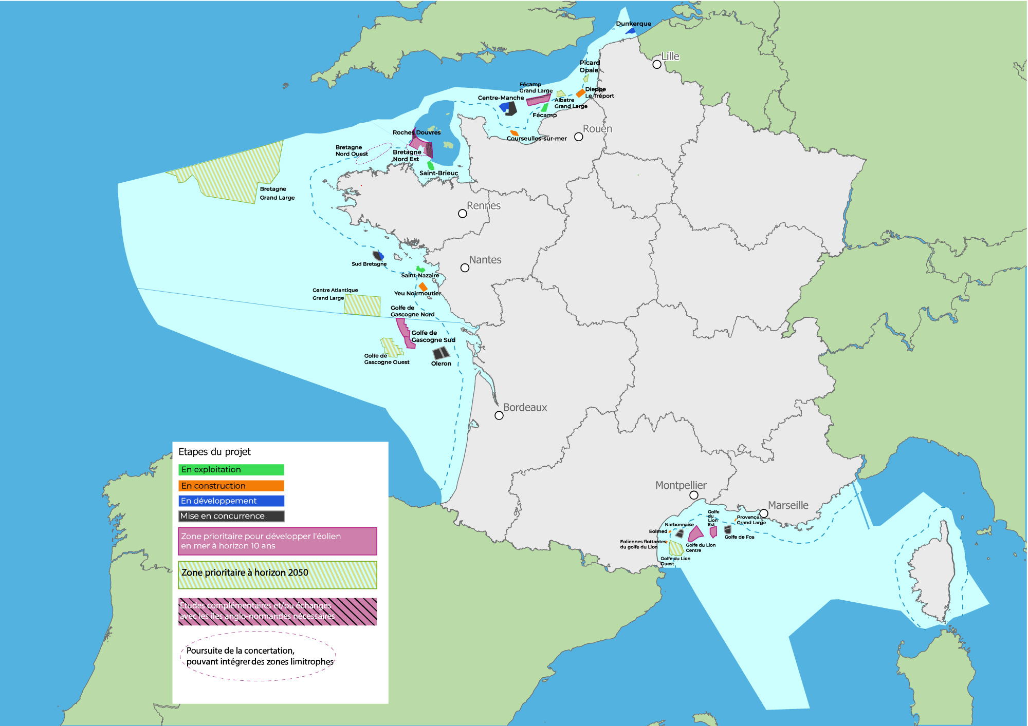
From AO1 to AO9 :
Floating
1,5 GW | In operation
1,5 GW | In construction
2,4 GW | In development
5 GW | To be awarded by 2026
0,75 GW
1,5 GW
10,4 GW installed
by 2032/2033
2,25 GW
+ between 8,4 and 9,2 GW in the AO 10 launched this year and awarded by 2027
including between 4,4 and 5,2 GW of floating offshore wind
Objective of
18 GW in operation by 2035 and 45 GW by 2050
(objectives of the offshore wind pact signed in 2022 between the industry and the Government)

Slide 2
By 2050
45 GW
15 GW
18,7 GW
6,6 GW
4,7 GW

Slide 3
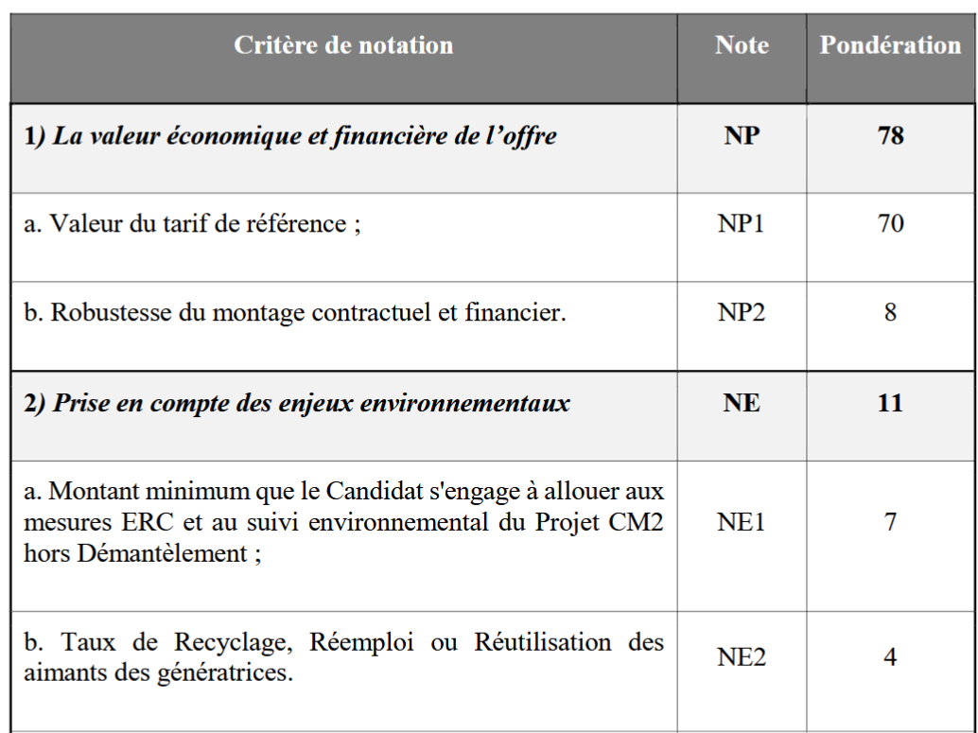
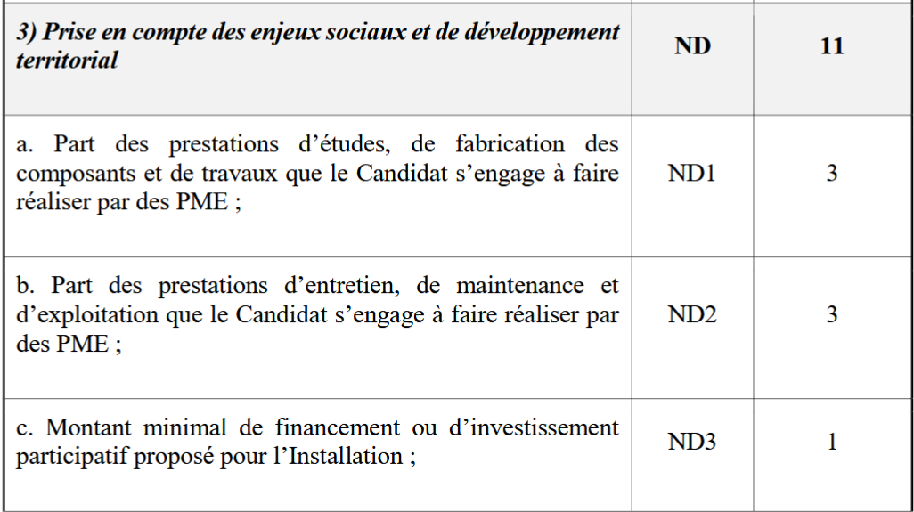
Non-price criteria in French offshore wind tenders
11 points out of 100
but only commitments

Slide 4
Multi-use and coexistence in offshore wind farms
Importance of dialogue while elaborating maritime spatial planning → integration of all stakeholders
Before and after being awarded, permanent dialogue between the developers and the other stakeholders :
For the layout of the wind farm ;
For the establishment of the rules of coexistence in construction and operation phases ;
To capitalize on good practices for next tenders and next wind farms
General framework to maximize coactivity the specification of the tender and then case-by-case approach by each developer with local stakeholders

