Slide 1
French Marine spatial planning process
Public and stakeholder consultation
27/03/25
Notes:
DGAMPA

Slide 2
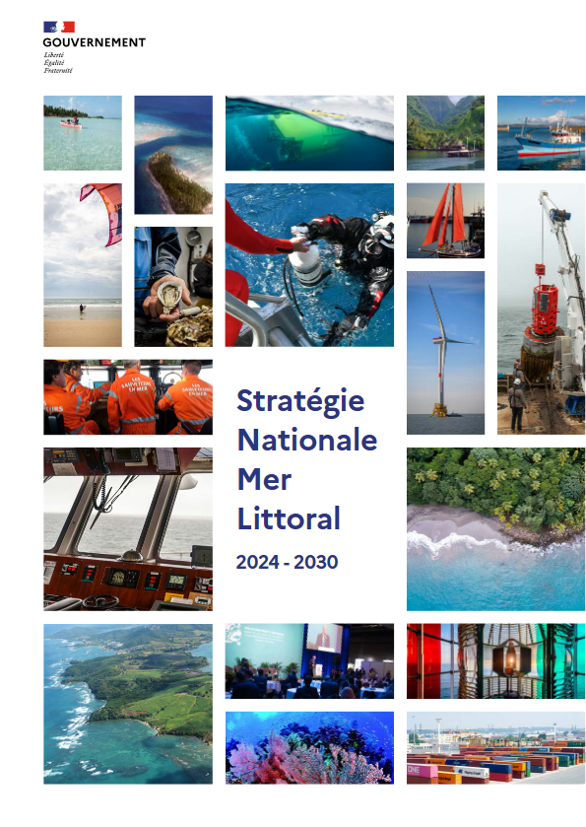
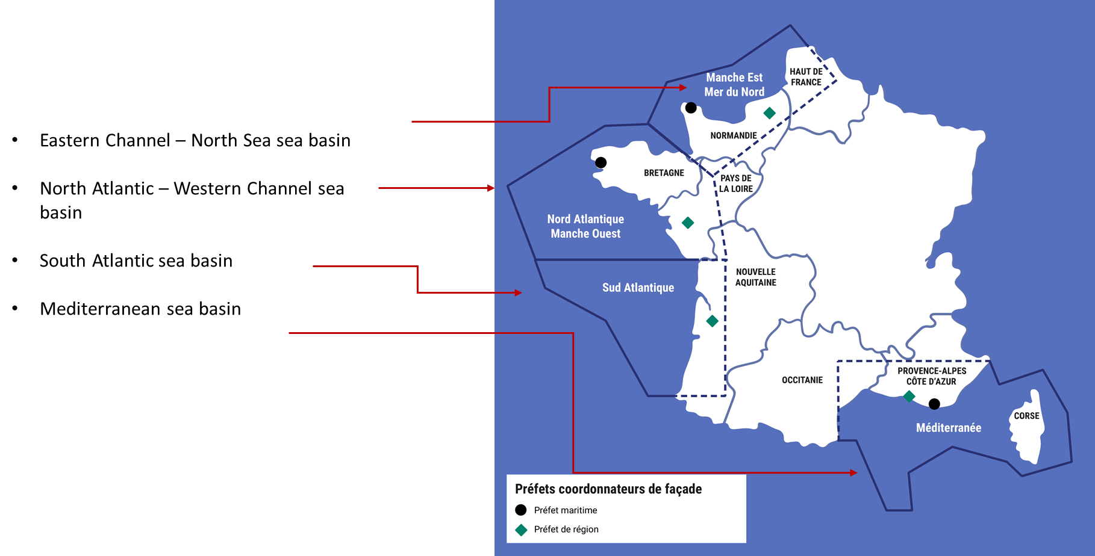
The French MSP: a two layer planning strategy
The national strategy for the sea and the coast is the reference framework for all players and, first and foremost, for public policies concerning the sea and the coast.
Sea basin strategy documents declining at a local level the objectives of the national strategy (4 mainland and 4 overseas)
2

Slide 3
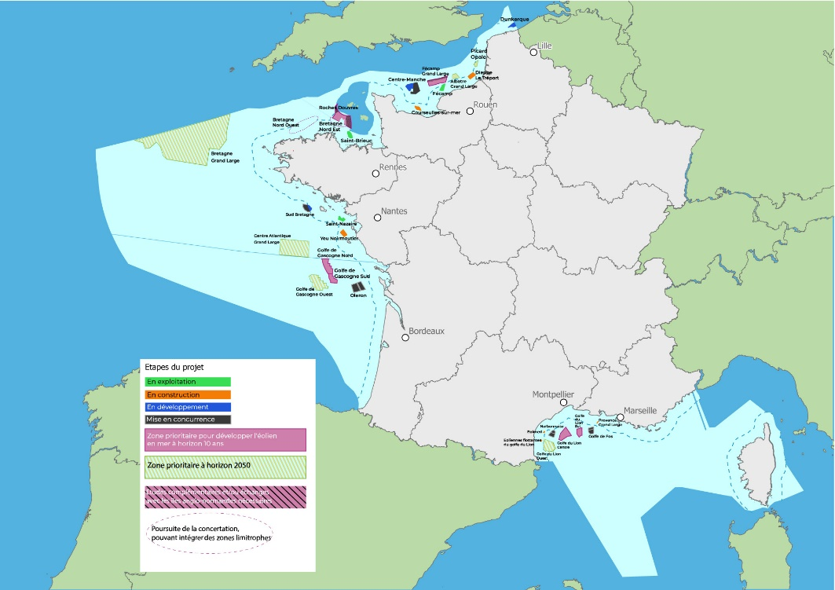
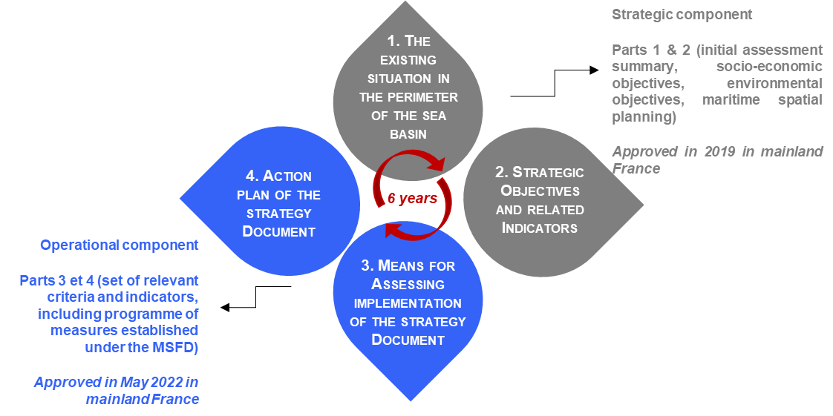
French public debate : an upstream public consultation designed to deal with all maritime issues
1. Update of the four sea basins strategies on the metropolitan French sea
2. A map of priority maritime and terrestrial zones for development over the next ten years and toward 2050
3

Slide 4
French public debate : goals and numbers
5 months debate : From Nov 2023 to Apr 2024
4 consultations on the four metropolitan sea basins
375 events
21 000 participants
Project owner: The State and the French TSO (RTE)
Organizer of the consultation: National Commission of public debate
Main goals
45 GW of installed offshore wind by 2050
5% of strong protection areas by 2030
Sustainable development of activities
Followed by 5 months of deepen concertation with maritime stakeholders

Slide 5
French public debate : how to ensure public and stakeholders participation
Four main modalities for public participation
An online debate: a participatory platform that allowed the public to ask questions and a digital participatory tool intended for the general public.
Sea trails: Between November 2023 and March 2024, localized events took place along the entire coastline, in the form of a mobile debate and stops at each coastline, including workshops and public events.
The Sea in 3D was a complementary event intended to be common to all four sea basins, and whose goal is to understand the interfacing issues.
Maps in debate was a modality built to make people participate on maps

Slide 6
From public and stakeholder consultation to offshore wind planning
Inter ministerial decision of 17th October 2024
Offshore wind - Two mappings for each maritime area:
A map of priority maritime and terrestrial zones for development over the next ten years.
A map with a 2050 horizon.
Objective : Launch tender procedures for 8 to 10 GW in 2025 (AO10)
Study areas identified for the development of strong protection on four sea basins
Follow-up to the all maritime planning process

Slide 7
